Slide 1

CS 533 INTRO TO DATA SCIENCE
Michael Ekstrand

Slide 2
INTRODUCING REGRESSION

Slide 3

Learning Outcomes (Week)
Compute single- and multi-variable linear regressions
Test for violations of linear model assumptions
Measure the predictive accuracy of a regression model
Photo by John Rodenn Castillo on Unsplash

Slide 4
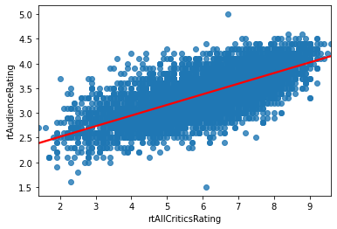
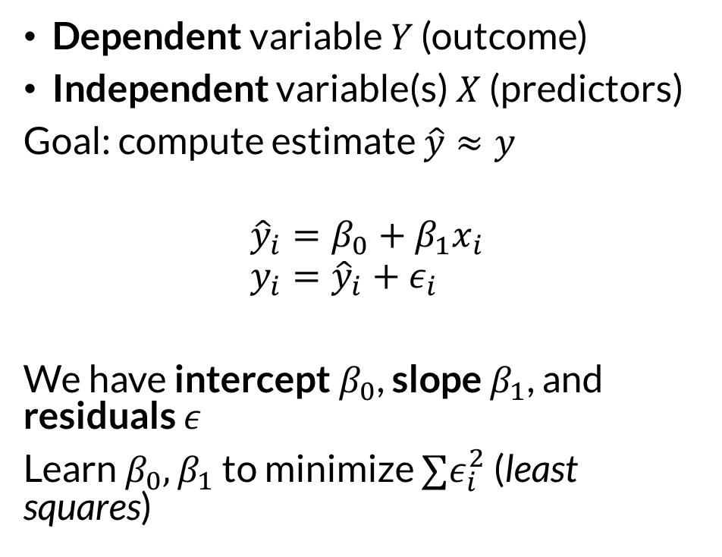

Variables and Model
Dependent variable $Y$ (outcome)
Independent variable(s) $X$ (predictors)
Goal: compute estimate $\hat{y}≈y$
$${\hat{y}}_{i}=β_{0}+β_{1}x_{i} \\ y_{i}={\hat{y}}_{i}+ε_{i}$$
We have intercept $β_{0}$, slope $β_{1}$, and residuals $ε$
Learn $β_{0},β_{1}$ to minimize $∑ε_{i}^{2}$ (least squares)

Slide 5
What Is a Model?
A mathematical representation
Of the essential dynamics
Of a system of interest

Slide 6
Purposes of Modeling
Understand predictor/outcome relationships
Correlational, not causal (at least alone)
Predict future outcomes
Estimate hypothetical outcomes
Correct for effects for further analysis
Regression predicts (or estimates) a continuous variable

Slide 7
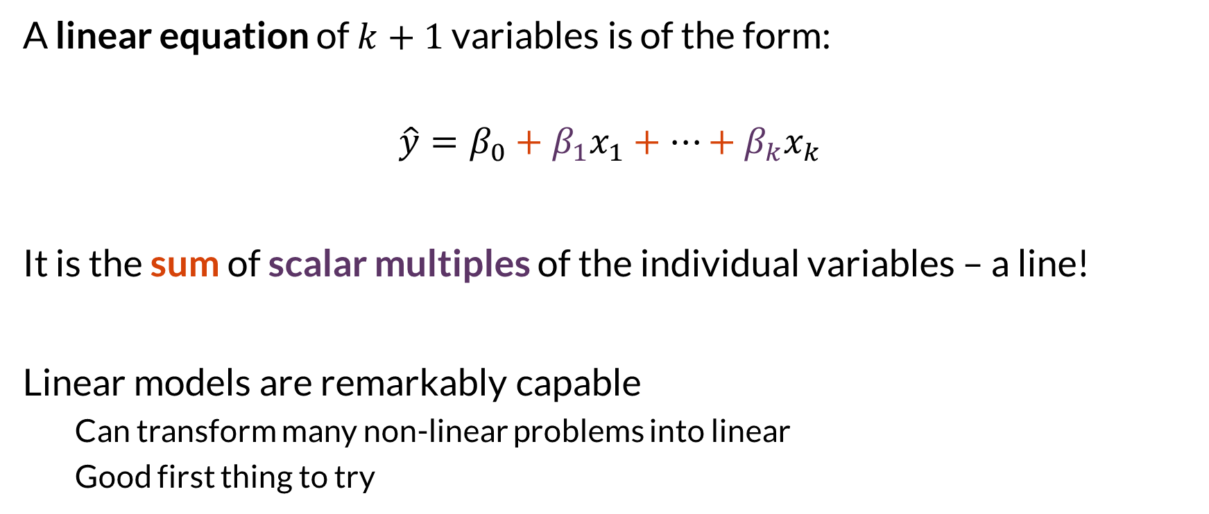

Linearity
A linear equation of $k+1$ variables is of the form:
$$\hat{y}=β_{0}+β_{1}x_{1}+…+β_{k}x_{k}$$
It is the sum of scalar multiples of the individual variables – a line!
Linear models are remarkably capable
Can transform many non-linear problems into linear
Good first thing to try

Slide 8

Wrapping Up
Models summarize data generating processes and let us predict future outcomes.
Linear models are a particularly simple but flexible class of models.
Photo by Drew Graham on Unsplash

